Slide 1


Slide 2
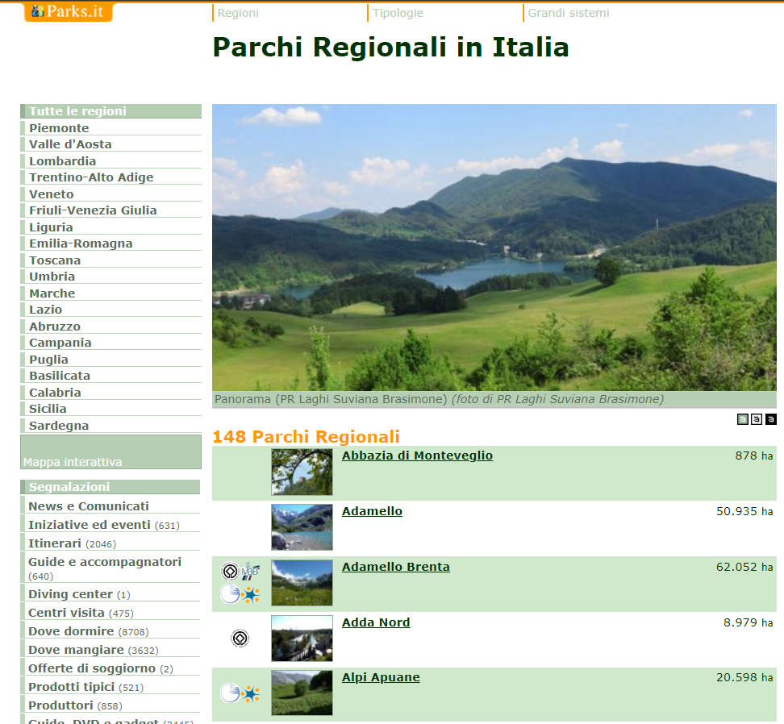
Case Study
The object under examination for the realization of the end-of-module project will be the management of a census of ONLY the fauna in the various natural parks of the Italian regions.
The information that will be entered will concern the order of belonging (mammals, reptiles, birds, etc ...), the species (squirrel, fox, bear, viper, hawk, eagle, etc ...), the number of specimens (with distinction male, female), the state of health of each specimen. Each animal has a GPS linked to an ID for identification. In each park, a manager (park ranger) collects information through software installed on the supplied notebook; the program, after acquiring the data from the input masks, stores them in a database.
For reasons of timing, it will be a very simplified scheme and DB, it will not take into account some specifications which are certainly important in reality, such as the management of Flora, the categories of flora.
The final goal will be to have a simple DB on which to perform interactions in SQL language and, subsequently, to use the POWER PIVOT DataModeling for the creation of a multidimensional DashBoard where to expose data meanings of given analysis.
The data used was taken from open Parks.it. Only a portion of the data has been extracted to simplify the presentation.
Data Source: https://www.parks.it/indice/PR/index.php

Slide 3
What tools did we use?
Visio
Sql Server - TSQL
Excel, Power Query, Power Pivot
With visio we created the e-r and logical model for how to implement the OLTP database
On SQL Server, using the TSQL language, the database was created starting from the logical model with DDL and DML queries and, subsequently, with DQL queries, interrogating the DB to obtain the requested information, also creating views and exploiting constructs to increase query performance and response speed.
On Excel we exposed our DashBoard using Power Query for a final processing on the data and with Power Pivot for the creation of the Data Modeling. Through the views created in TSQL, normalizing the data, we have recreated a star schema with Power Pivot.

Slide 4
E-R Model

Slide 5
LOGICAL Model

Slide 6
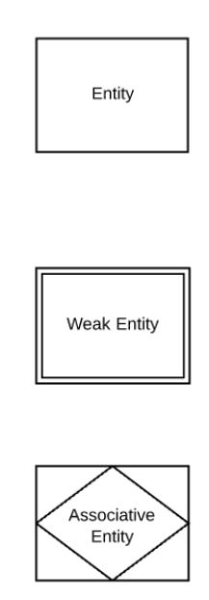
Difference between E-R and Logical model
E-R model is used to establish entities and relationships.
Logical Model describes the attributes of the entities in more depth, translates the E-R model making it efficient regardless of the DBMS that will be used.

Slide 7
Data creation
DB Creation
Exploration
We created a fictitious database, populating it with data extracted from Parks.it and other sources, reporting everything in an .xlsx file
Click here:
We created the database, that is, the tables and massively loaded the data.
Click here:
To test Database functionality and data consistency, it was queried with various queries to extract data based on requests.
Click here:

Slide 8
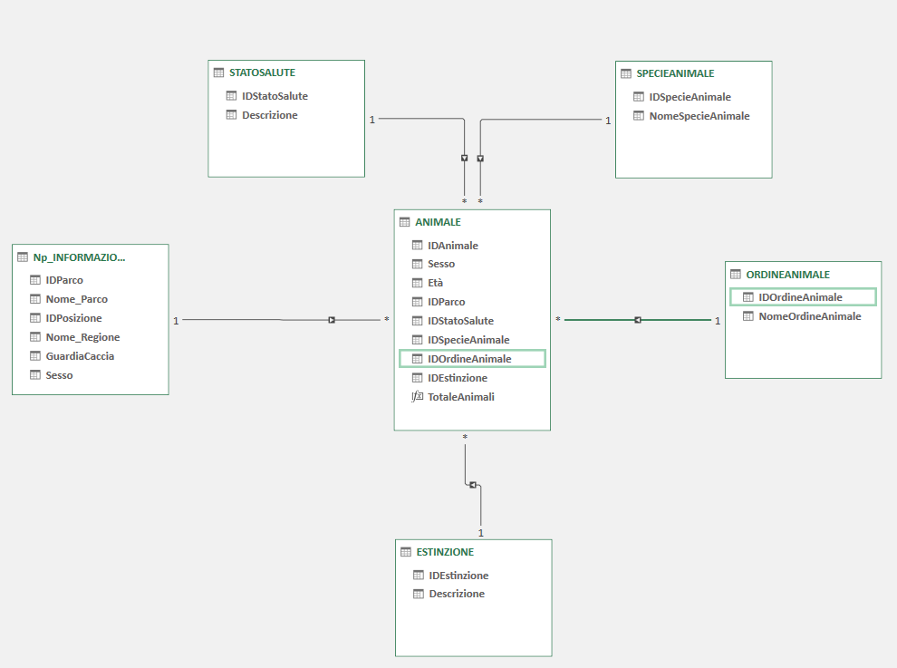
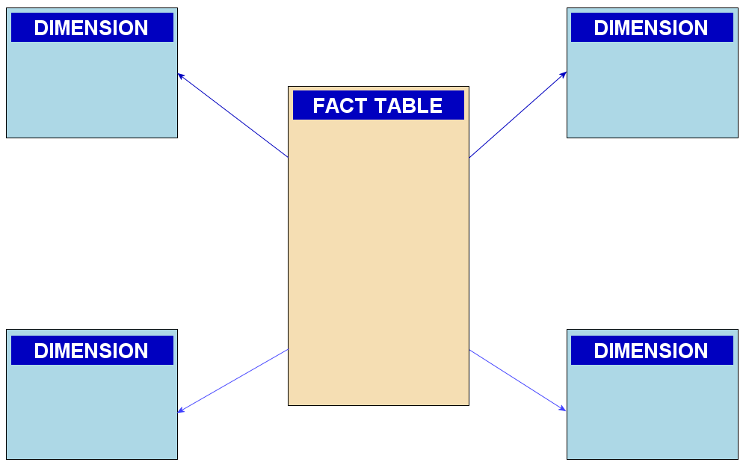
Data Preparation
The first part of ETL was done on the data source, creating views for normalizing the DB and being able to transmit almost ready data to Power Query.
Click here:
In Power Query we complete the last stages of transformation and, subsequently, we create the DataModeling in Power Pivot and, using the views, we create a StarSchema.
A star schema is a multi-dimensional data model used to organize data in a database so that it is easy to understand and analyze. Star schemas can be applied to data warehouses, databases, data marts, and other tools. The star schema design is optimized for querying large data sets.

Slide 9
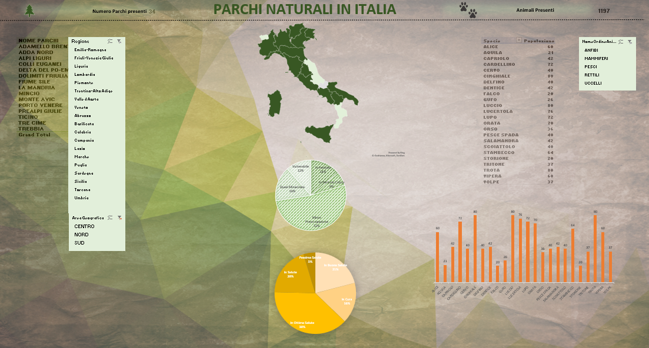
DASHBOARD

